Slide 1
Sharing the St. John’s River Experience
Through a VERY Special Event
We can take a cue from New Jersey Power Boat Club.
It is an organization made up of volunteers from all over New Jersey and surrounding areas that share the
love for power boating and sharing something special with others that are less fortunate.
They hold an annual event for members of their surrounding community.
It is called Shore Dreams for Kids.
https://vimeo.com/140340299

Slide 2
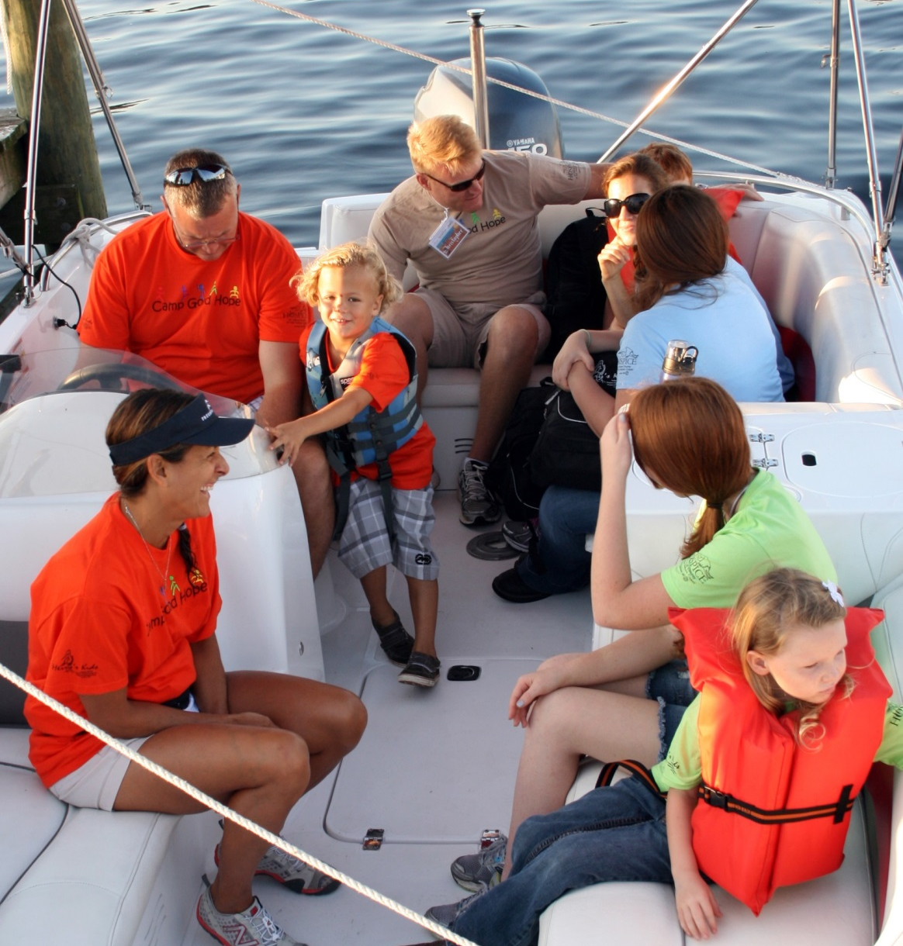
What Is It:
It is a single day event put on by about 200 volunteers, put on at a local park
Children and Special Needs Adults from throughout the area are invited
These are people who would never have been able to experience the water without this event
It costs no money to attend
Shore Dreams for Kids has been going on for about 20 years, even overcoming Hurricane Sandy
Participants eat lunch, play games on shore, and then close out the day with a boat ride

Slide 3
Jacksonville Has What It Takes:
Metro Park Offers Dockage and Recreational Space to Host an Event
A Public-Private Partnership would easily supply food & etc.
There is a strong boating volunteer base who would give this support
Parks and Recreation Dept., Mayors Disabled Services, Brooks, Special Olympics, and Duval County School Board input would be crucial
Future events could include a stop at the Zoo
There are already similar events taking place on a small scale. COJ support is needed to make awareness broader and spotlight the enrichment that the St. John’s River brings to Jacksonville
The goal is to get more people out on the river and change the perspective of those who are not familiar with it

Slide 4
Capt. Suber’s Safety Talk
ALL ABOARD FOR ………..

Slide 5
Let’s do this!

